Slide 1
Recent changes in Lithuanian Culture policy and artists in the changing environment
Conference for Creative Associations – Latvia, Lithuania, Estonia
Dainius radzevičius
Lithuania

Slide 2
In 2013, after the reform of culture and arts projects funding system the Lithuanian Council for Culture was founded – an institution for implementation of culture.
One of the most important first political efforts to change the concept and direction of cultural policy in order to democratize and strategically strengthen cultural policy was realized by separating cultural policy formulation and implementation functions and establishment of the Lithuanian Cultural Council. It has been argued that this has led to a arms length management model in the cultural sector.

Slide 3
In 2017, with the participation of 43 European countries, the Cultural and Democracy Indicator (IFCD) is a very clear link between culture and democracy. According to the economic value created by the cultural sector, Lithuania is ahead of most European countries. However, Lithuania lags behind the average of other European countries in terms of accessibility and equilibrium of cultural activities and services, which in turn also affects the activity of civil society in Lithuania.

Slide 4
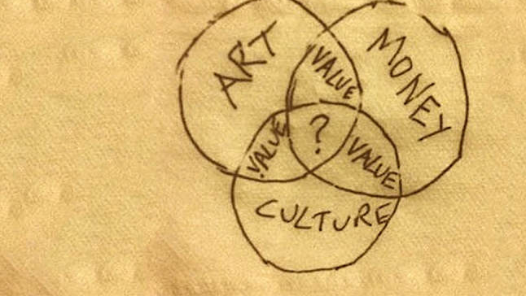
Government attitude towards culture
March 13, 2017
The plan for the implementation of the Government Program approved by the Government of the Republic of Lithuania also covers a wide range of areas.
At that time, Liana Ruokytė-Jonsson, former Minister of Culture, highlighted three priorities: the strategic role of culture in public policy and life, the quality and accessibility of cultural services in the regions, and the reform of cultural management and funding.

Slide 5
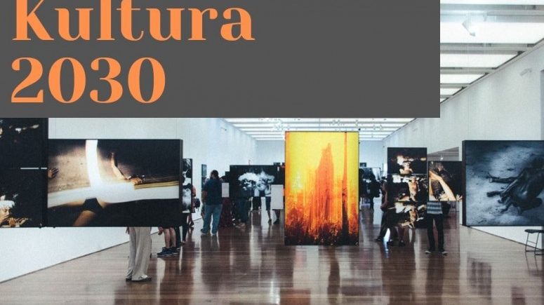
In order to consolidate culture as strategically important for the life of the state, it was planned to prepare a Law on the Fundamentals of Lithuanian Cultural Policy, which will clearly regulate and consolidate the state's obligations to culture. It was also planned to prepare a Law on Patronage, which would enable new sources of funding for culture and thus become a catalyst for culture. The plan also provides for the preparation of the Lithuanian Culture 2018-2030. strategy and a system for monitoring and analyzing culture and art.more importantly a more sustainable format.

Slide 6
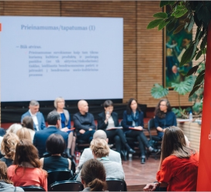
Strategic financing directions in 2019–2021
The Lithuanian Council for Culture (LCC) that started its operations last June approved its strategic financing directions for 2019–2021. In view of the overall development of culture in Lithuania and its social climate, also with reference to the findings of the recent years’ studies in the area of culture, the LCC identified diversity, education and the accessibility of culture as its key strategic directions for financing.

Slide 7
STRATEGIC OBJECTIVE: Incorporating culture into an open society and the well-being of the population
DIRECTION I: A balanced and integrated cultural policy.
DIRECTION II: Creative personality and a strong identity society.
DIRECTION III: A culture that creates economic value

Slide 8
strategic cultural policy purpose: "Inclusive culture for an open society and for the well-being of the population."
1. Quality cultural services for Lithuanian residents are available evenly regardless of their place of residence.
2. Cities act as vibrant cultural foci. Their dynamic cultural life contributes to the attractiveness of the regions.
3. People working in the cultural sector and those who create culture are rewarded for their work. The jobs in the sector are competitive, creating opportunities for creativity and professional development.

Slide 9
strategic cultural policy purpose: "Inclusive culture for an open society and for the well-being of the population."
Cultural activities involve the population, provide opportunities to develop their cultural and creative abilities, and enrich their personality.
Cultural activities reinforce public solidarity. Society actively participates in public discourse, preserving, memorizing and actualizing its history, creating and strengthening the identity and traditions of multicultural Lithuania.
Cultural activities involve people of different ages and sexes and people from different social groups.
The use of cultural resources is envisaged in other sectoral policies, creating added value in them.

Slide 10
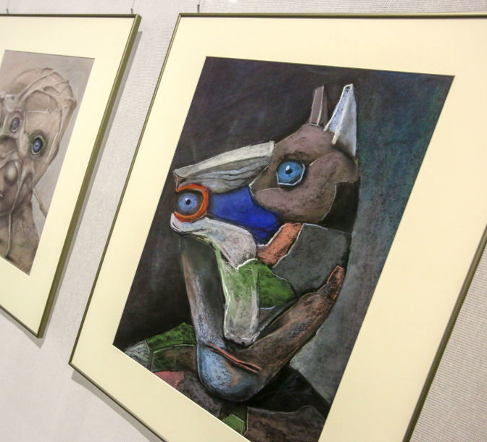
Culture 2030: Lithuania cannot guarantee the transmission of the most outstanding works to future generations
Lithuanian museums are not financially capable of consistently collecting the works of contemporary art creators, so the state cannot guarantee the transmission of outstanding cultural and artistic works to future generations, according to the culture policy strategy “Culture 2030”. It was prepared by the Ministry of Culture.

Slide 11
Culture 2030: Lithuania cannot guarantee the transmission of the most outstanding works to future generations
According to the Ministry, private business support, patronage may be implemented to solve the problem, but the state has to concentrate its resources and remove regulatory obstacles to support private sponsors.

Slide 12
Culture 2030
Attention is drawn to the problem of attracting sponsors (private individuals). Compared to Western states, the level of charity, including cultural patronage, remains low in Lithuania.
According to the Ministry of Culture, the funds of the sponsors of state performing arts institutions in 2017, compared to 2015, decreased by 23%. This decrease is partly due to the new restrictions on alcohol advertising launched in 2017.

Slide 13
Culture is less interested in men and seniors
The aim is to involve people in different cultural activities - different age, gender and different social groups - to create conditions for fostering cultural and creative skills.
According to the ministry, participation in cultural activities and consumption of cultural services has been steadily decreasing among older population groups, women are engaged in creative activities and use cultural services more often than men.

Slide 14
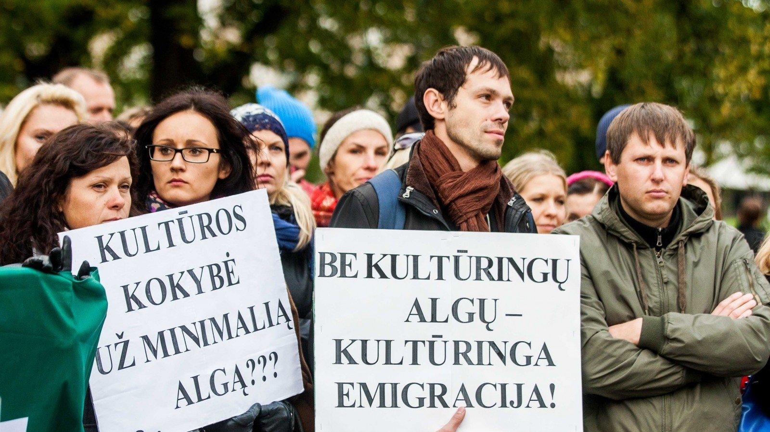
Requirements are high - salary is exceptionally low
Another aim is a decent wage and appropriate conditions for workers and creators in the cultural sector. According to the data of the Ministry of Culture, the average salary of Lithuanian cultural workers is the third lowest in the European Union after Romania and Bulgaria.
According to the data of the Department of Statistics, 20,000 Lithuanian residents work in the cultural sector, of which 13,000 work in the subordinate institutions of the Ministry of Culture, other ministries and municipalities. This means that more than a third of cultural workers work in non-governmental organizations private sector.

Slide 15
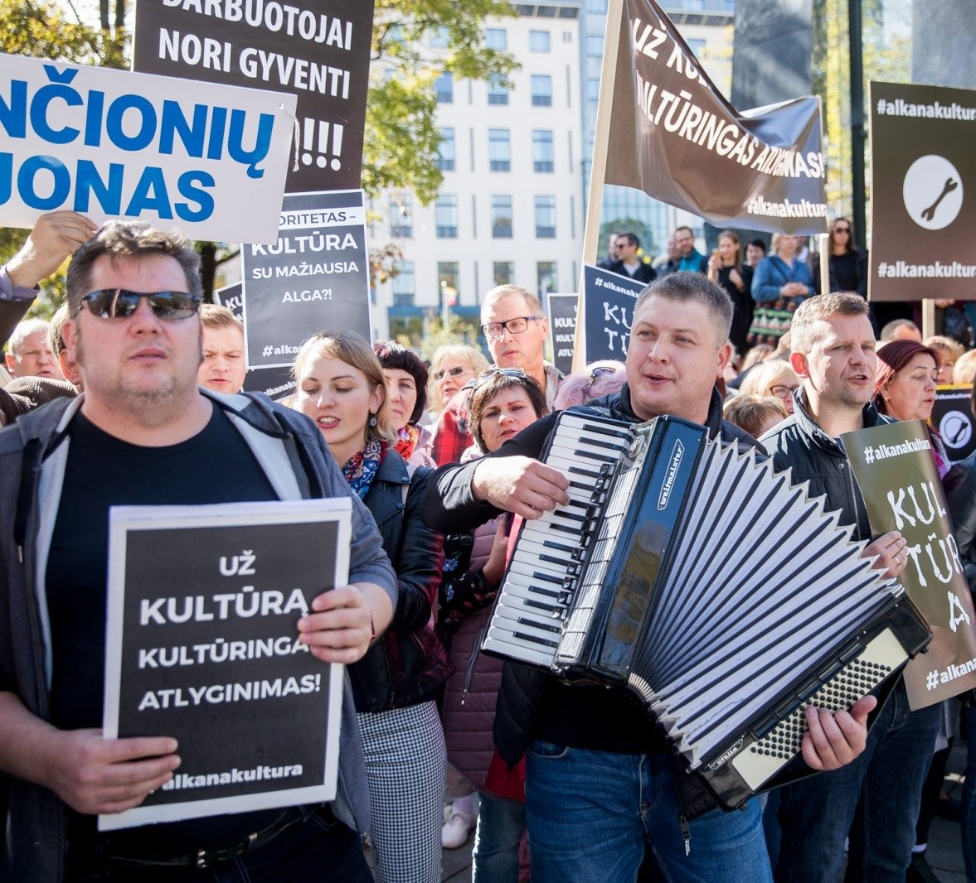
“Comparing wages of Lithuanian public sector cultural workers with other areas of public sector services, lower wages are only for guardians (non-medical services) specialists and postal couriers, that is, only in areas where the required qualification is minimal. The majority of cultural workers are subject to the highest standards of professional excellence (performers of national concert venues, theater actors, museum and librarians), ”noted in the Culture 2030 strategy, adding that poor remuneration has a major impact on the attractiveness of jobs in the sector and has a negative impact on culture. quality of service, promotes the outflow of creative resources from the country.

Slide 16
step by step
This year, the earnings of cultural workers, on the basis of increased funding and wage increases due to tax changes, will rise by an average of 88 euros. This is what the Ministry of Culture says.
Next year, wages of culture and art and social workers should rise by 15 percent. This was reported at the end of January by Vice-Chancellor Deivid Matulion. As a result, it was agreed by a government commission led by it to discuss a strategy for increasing public sector wages.

Slide 17
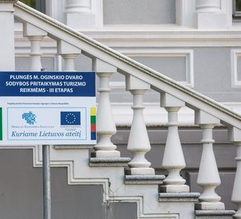
In 2014-2020, Lithuania received LTL 469.4 million. EU investment. Although there were interinstitutional agreements and expectations to attract funding not only for the modernization of infrastructure but also for cultural content (soft activities through other public policy areas).
This has led to systemic problems not being addressed in a complex way. There was not enough investment in the training of employees and promotion of cultural entrepreneurship, lack of investments in the strengthening of art and science relations, innovative solutions improving the quality of cultural services.

Slide 18
Creative associations belonging to the Lithuanian Association of Art Creators often feel marginalized by government institutions. However, we are concentrating our members and working creatively. The formation of Lithuanian cultural policy does not always take into account the expectations and problems of creative unions, and their representatives are often not invited to participate in important meetings, which discuss issues important to those organizations.
The unions that unite artistic creators today are modern, presenting contemporary art trends, but also preserving the historical and traditional heritage of an organization seeking to improve the status of an art creator in a variety of ways and with rational means.

Slide 19
The future belongs to the creators of ART and culTure
Dainius Radzevicius
dainius@dainius.org
+37061263838
Skype dainius.radzevicius

