Slide 1
State support for creative arts and organizations of art creators in Lithuania. Presentation of the system of state pensions for artists and the program of art creators’ social security at the ministry of culture in Lithuania
Dainius Radzevičius

Slide 2
The Lithuanian Council for Culture
Implementation of the strategic programs of art creators' organizations
The purpose of the program Ensure the implementation of strategic programs of organizations. The financing of one organization in a calendar year is not less than 20 000 EUR. 2018 - EUR 721 000; 2019 - EUR 721 000; 2020 EUR 721 000

Slide 3
The Lithuanian Council for Culture
Organizations must meet one or more of the following: 1. ensuring artistic creativity, disseminating and promoting consistent creativity and publicity and accessibility to society (thematic conferences and seminars / events for members of the association: exhibitions, competitions, awards, etc. / dissemination of information / representation of the association's information and its members for the interests of artistic creators); 2. To create conditions for the development of creative and professional development of young artists (periodically present young artists' works, organize master classes, seminars, awards, etc.); 3. To implement international and interregional projects (projects, international cooperation, visits, exchanges, cooperation and projects related to other areas: education, social protection, etc.); 4. Ensure the preservation of artistic heritage and cultural memory (gathering information about creativity, digitization, memory preservation of association members); 5. ensure the monitoring of the creative and social situation of artistic crews and their organizations and the accumulation of statistical data (accumulation and processing of statistical data specified in the Law on the Status of Art Creator and the Status of Art Creator); 6. Participation in the activities of Lithuanian and international professional organizations or networks (contributions for international and Lithuanian organizations or networks, participation in conferences, seminars, etc.).

Slide 4
The Lithuanian Council for Culture
The Lithuanian Council for Culture (hereinafter: “the Council”) carries out its activities from the year 2013, in accordance with the Law on the Lithuanian Council for Culture, the Law on Culture Support Fund, the Government decrees, the Minister of Culture orders, the Council Statute and other legislation. The Council is a budgetary institution, established with the view to reform country cultural governance and develop culture self - realization.

Slide 5
The Lithuanian Council for Culture
Core mission - to implement the State culture policy in the governance areas assigned to the Minister of Culture, except for the areas assigned to the Lithuanian Film Centre, which is a separate institution under the Ministry of Culture responsible for the country cinema policy implementation.
The owner of the Council is the State. The rights and duties of the owner are implemented by the Ministry of Culture with the exception of decisions related to reorganization or liquidation of the Council, which are taken by the owner – the Government.

Slide 6
Grants for individuals
Lithuanian Council for Culture is awarding individual and educational grants to culture and art creators. To be eligible for the grant, candidates have to be adult culture or art creators, whose object of activity is Lithuanian art and culture and their promotion. Applications for grants may be submitted by the citizens of the Republic of Lithuania as well as citizens of other EU Member States or third countries, however, the application must be completed in Lithuanian. All the application appendices must be also submitted in or translated into Lithuanian. Candidates may apply only for one specific type of grant.

Slide 7
Individual grants
Individual grants are awarded to support individual artistic activities of culture or art creators. Individual grants of €600 per month may be awarded for a maximum of 2 years. Applications for individual grants may be submitted annually from September 1 to September 30.

Slide 8
Education grants
Education grants are awarded for improving the professional skills of culture or art creators, in particular, for participating in traineeship programs, courses, conferences, symposiums and other activities for building up professional skills. Education grants may also be used for covering the costs of creative residency or masterclasses. The grant may be awarded for a maximum of 6 months. The grant of up to €3,600 is paid out after signing an agreement. Applications for educational grants are accepted three times a year

Slide 9
Agreements and reports
After being awarded an individual or educational grant, the candidate must, within 20 working days, fill in and sign an agreement form (in Lithuanian) for the type of the grant awarded (individual or educational).
The report for the grant received must be submitted no later than one month from the end date of the activity period, as defined in the agreement terms. The report for the grant received does not need to include copies of documents for justifying expenditure.
2018 – 119 grants. 153 330 euros

Slide 10
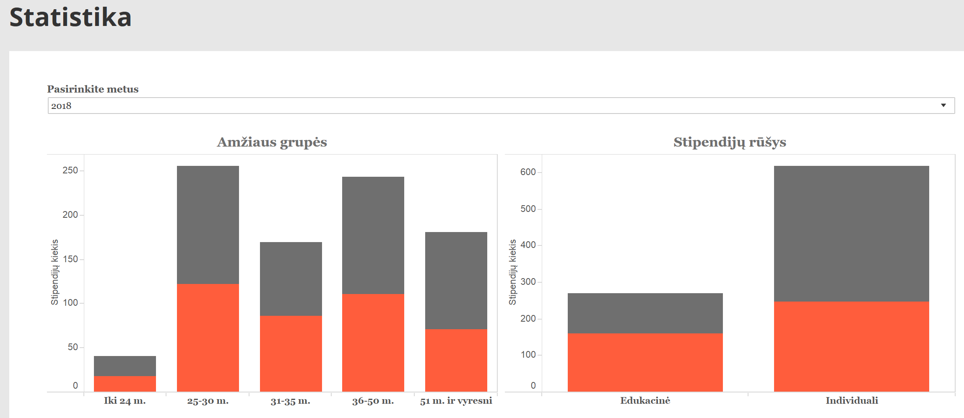

Slide 11
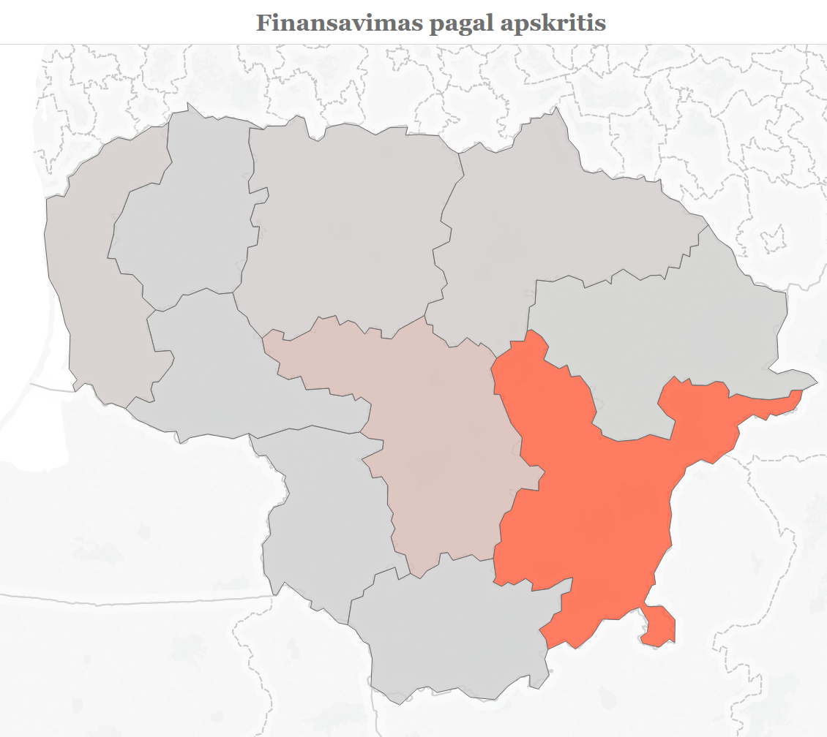
Grants and regions of Lithuania

Slide 12
State Support for Producers of Public Information
The State shall support cultural and educational projects of producers of public information which are legal persons.
State financial support shall be provided to producers of public information by tender and through the public establishment Media Support Foundation

Slide 13
Media Support Foundation
The Foundation shall be a non-profit public limited liability legal person with an aim of providing support on the basis of an invitation to tender for projects of producers of public information in the fields of culture, security of provision of information to the public and media literacy education as well as educational projects.

Slide 14
Media Support Foundation
The Foundation shall, by tender, support projects of producers of public information in the fields of culture, security of provision of information to the public, media literacy education under the following six programmes:
1) cultural, art publications;
2) national periodical publications;
3) regional periodical publications;
4) national radio and television;
5) regional radio and television;
6) the Internet media (information society media).

Slide 15
Media Support Foundation
Cultural and educational projects submitted to the Foundation shall be evaluated by experts. All experts must have a university degree and at least five years’ experience in the fields of provision information to the public, culture or education, be of good repute, and have special knowledge, skills and competence necessary to evaluate the submitted projects. Experts shall be subject to the same criteria as civil servants that are established in the Law on Civil Service and on the basis of which a person may not be considered as having good repute. Experts shall be appointed for a period of two years and the same person may not be a member of the experts’ group more than two consecutive terms of office.

Slide 16
Media Support Foundation
Heads of cultural and artistic organizations, their deputies, heads of agencies established by them, employees of the Foundation may not be experts. Also, an expert may not be an individual whose close persons, as they are defined in the Law on the Adjustment of Public and Private Interests in the Civil Service, have employment, copyright or other contractual relations with the participants of the Foundation.

Slide 17
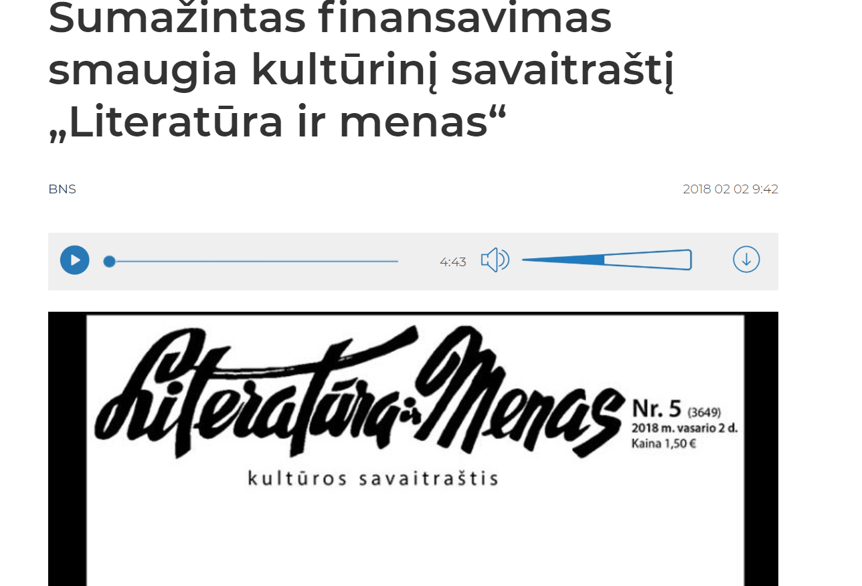

Slide 18
Social protection of art creators
Since 2011, persons of working age who have the status of a creator of art are insured with pensions, sickness and maternity social insurance with state funds from the minimum monthly salary approved by the Government. This procedure applies to persons who do not have insured income.

Slide 19
Social protection of art creators
Since 2012 art-makers who have no work and income from it, are insured by public funds under the Health Insurance Act. Art makers themselves should not apply for social insurance and compulsory health insurance anywhere. The necessary data is exchanged between the authorities of the respective state. The Ministry of Culture "Sodra" provides data on persons who possess the status of an artist.

Slide 20
First and second degree pensions
Winners of the National Culture and Art Award can receive a state pension
1st and 2nd degree state pensions
The first-class state pension is the size of four state pension funds (232 Eur).
The second level state pension is the size of two state pension bases (116 Eur).

Slide 21
Social protection of art creators
State-recognized artists' rentals are still a dream project

